Slide 1
EART 28202 : Structural Geology
Class 3 : Strain
Notes:
The contents of this class and that describing stress (Class 5) are fundamental for taking a more quantitative approach to rock deformation/structural geology. This is where mere description starts to turn into modelling (conceptual, analytical or numerical) and hence into the development of a deeper understanding of how rocks deform
In the notes panes to these slides there are numerous references (figure credits and further reading). If the reference is incomplete it refers to the references stated in the reading list on the last slide
With regard to figures in this PowerPoint file, many will be subject to copyright restrictions. I don’t care about you using any of the figures/photos that are mine (Steve Covey-Crump), although a credit would be nice, but take care to comply with copyright restrictions if you reuse any that are not

Slide 2
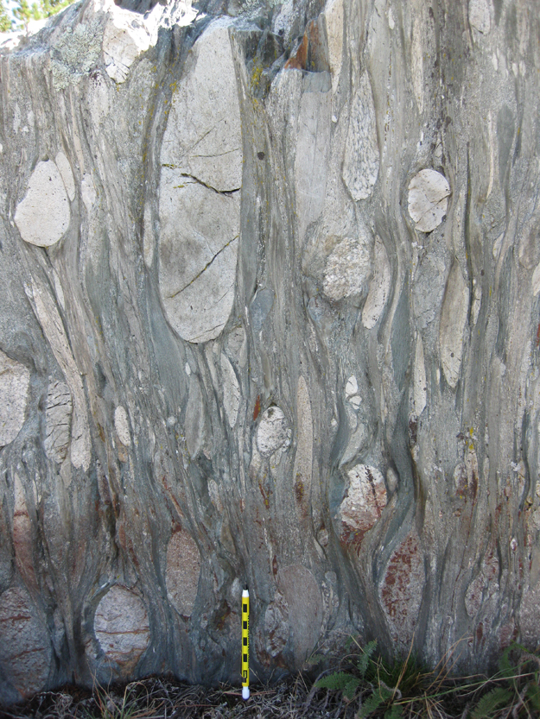
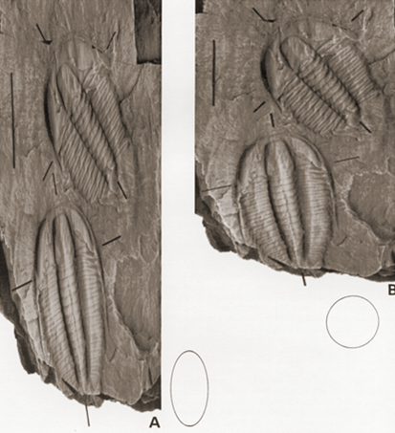
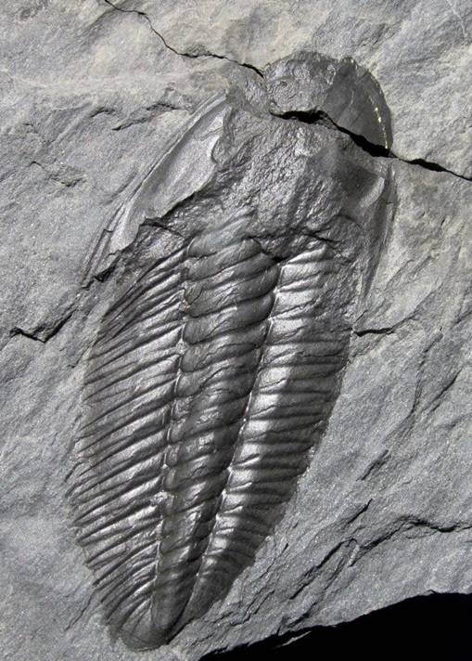
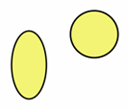
Quantifying deformation
To develop our understanding of the origin and significance of geological structures, we need to quantify the deformation that they record
This is achieved with the concept of strain – strain is a measure of the change in size and shape that a body experiences during deformation
Deformed and restored fossils of Angelina sedgwickii
Deformed conglomerate – note the flattening/elongation of the clasts
Notes:
The two photos on the left are from Rushton & Smith, 1993, Palaeontology 36: 927-930 (Fig. 1), linked from https://www.palass.org/publications/palaeontology-journal/archive/36. The photo in the middle is of a specimen of Angelina sedgwickii that was advertised on the internet for sale. Deformed fossils of Angelina sedgwickii are well known from early Ordovician (Tremadocian) mudstones around Porthmadog, North Wales, particularly on the north-western slopes of Garth Hill. This fossil is only known in a deformed state and so has been the subject of numerous attempts to undeform it to reconstruct its original shape (see Fortey & Owens, 1992, Geology Today 8: 219-221, https://doi.org/10.1111/j.1365-2451.1992.tb00459.x)
Photo right (from blogs.agu.org/mountainbeltway/2011/10/26/strained-timiskaming/): a deformed polymict conglomerate from the boundary between the Wabigoon and Quertico sub-provinces of the Superior Craton, Seine River, Ontario (on the Canada/U.S.A. border). The clasts have been flattened. A strain analysis of these conglomerates is presented by Czeck et al., 2009, Journal of Structural Geology 31: 1365-1376, https://doi.org/10.1016/j.jsg.2009.08.004. From their analysis the authors were able to place constraints on the relative strengths of the different clast lithologies

Slide 3
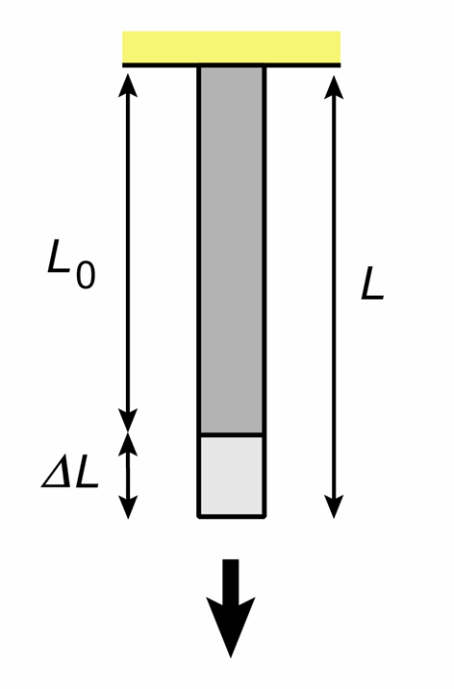
Changes in size (measures of linear strain)
Changes in size can be described as changes in length measured parallel to a set of reference directions; a change in length parallel to a given direction is described as a linear strain (or sometimes as a longitudinal strain)
Several different parameters are used to specify linear strain, each of which has its own advantages in different applications:
Engineering convention
Engineering strain (extension): e = ΔL / L₀ = ( L - L₀ ) / L₀
where L is the final length of the line, and L₀ is the starting length. It may be positive or negative depending upon whether the line has increased or decreased in length
Stretch: s = L / L₀ = ( 1 + e )
Quadratic elongation: λ = ( L / L₀ ) ² = ( 1 + e ) ²
Reciprocal quadratic elongation is also useful: λ ´ = 1 / λ
Logarithmic strain (natural strain): ε = ln ( L / L₀ ) = ln ( 1 + e )
e_{xx} = linear strain //x
Notes:
In the engineering sciences an increase in length is defined as positive; in rock mechanics a decrease in length is defined as positive. This is because in engineering the consequences of tensile forces are usually more relevant (materials are much weaker when being pulled apart than when being compressed), whereas in rock mechanics rocks at depth are almost always in a state of compression (due to the weight of the overlying rock) and so shortening is usually more relevant; the different sign definition simply removes the excessive appearance of negative signs in the relevant mechanical equations. The equation for engineering strain on this slide follows the engineering convention (lengthening is +ve); in the rock mechanics convention we have instead e = ΔL / L₀ = (L₀ - L) / L₀ which is simply the negative of the engineering convention
It is common practice to multiply strains by 100 to quote them as a percentage, e.g., a strain of 0.001 = 0.1%
When specified within a coordinate frame, linear strains should be accompanied by a subscript indicating the direction in which the strain is given, e.g., e_{xx} is the strain parallel to the x axis, e_{yy} is the strain parallel to the y axis, and e_{zz} is the strain parallel to the z axis. The doubling of the subscript reflects the matrix notation used for specifying the state of strain at a point (see Slides 9-13)
Figure by Steve Covey-Crump

Slide 4
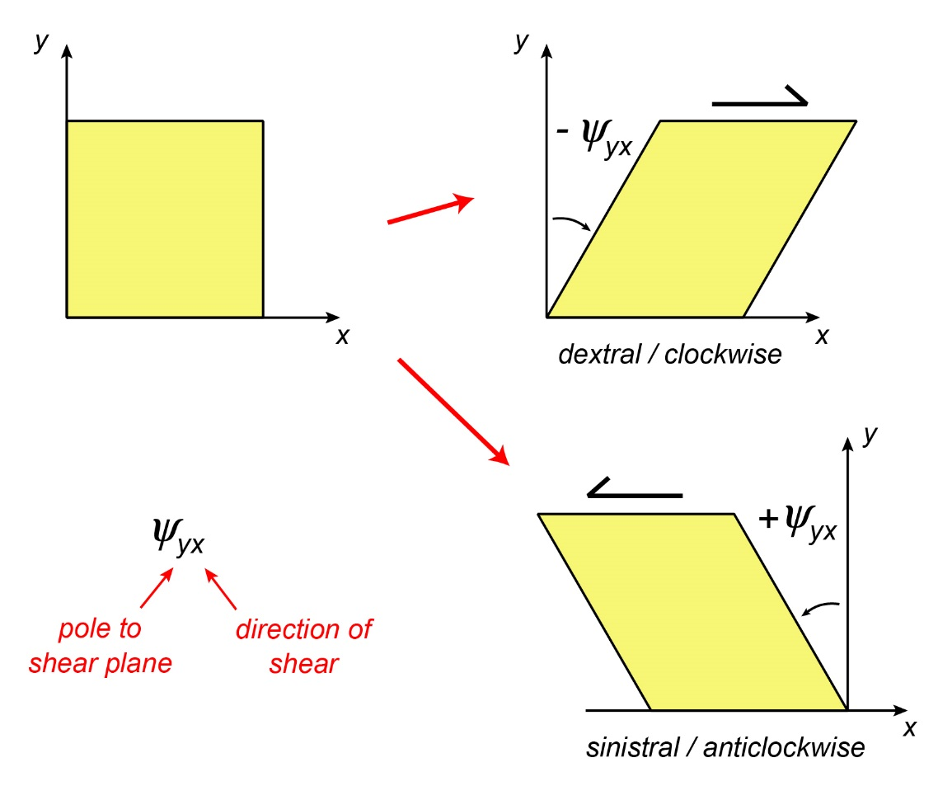
Changes in shape (measures of shear strain)
Changes in shape can be described as changes in angle between two lines; the change in angle between two lines is described as a shear strain
The change in angle between two lines that were originally perpendicular is known as the angular shear, ψ
Angular shear is positive for an anticlockwise rotation, and negative for a clockwise rotation
Engineering shear strain
γ = tan ψ
Gamma prime is also useful:
γ ´ = γ/λ
Tensor shear strain is one half the engineering shear strain
e_{ij} = γ_{ij}/2 ( i ≠ j )
Notes:
Different people have used different sign conventions for shear strain; the one shown on this slide is now standard. To establish the sign, consider how the pole to the shear plane has rotated. On a 2d plot like that shown here, a clockwise rotation is negative. For those of you familiar with the right hand rule for working out the sign of a rotation, note that the sign convention given on this slide is consistent with that: using your right hand, put your thumb along the x axis and your first finger along the y axis; your second finger (z axis) is now pointing towards you; now put your thumb pointing along the z axis towards you and you will see that your fingers curl in an anticlockwise sense, that is, anticlockwise is +ve
Note that the definition of engineering shear strain follows naturally from elementary trigonometry: tan ψ = Δx/y = γ
Double subscripts are needed when specifying shear strain in a coordinate frame. These indicate (1) the orientation of the shear plane and (2) the direction of shear in that plane
Figure by Steve Covey-Crump

Slide 5
Putting matters on a more rigorous footing
Notes:
Accompanying this PowerPoint presentation is a supporting document, StrainNote.pdf, that outlines key mathematical fundamentals in the theory of strain. You do NOT need to know the contents of this document for this course unit. However, anyone who takes up a career or further academic study in rock mechanics (e.g., in engineering geology or in many aspects of geophysics) will find that the contents of the document will become absolutely core to what they are doing

Slide 6
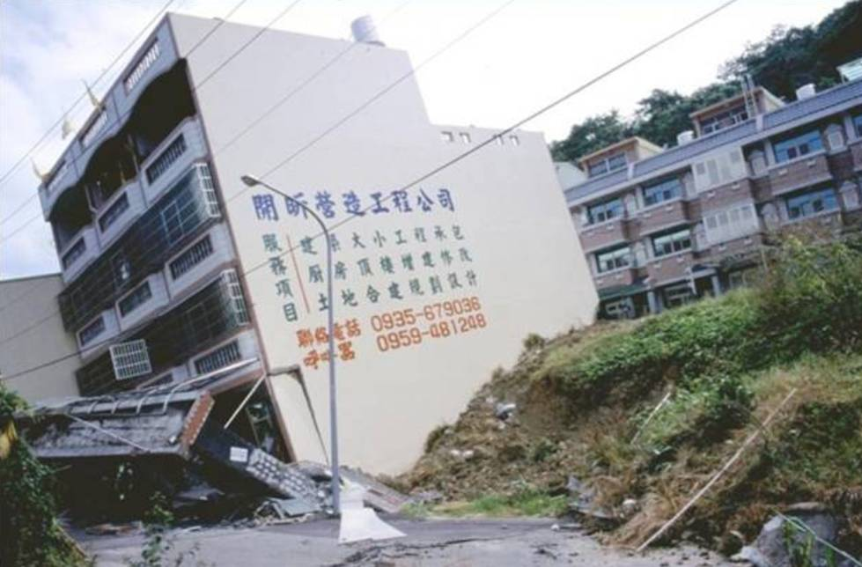
Displacement, strain, deformation
Quantifying deformation involves comparing the size, position, and orientation of some geological feature of interest in its initial and final states. In doing this, it is convenient to think of the feature as being made up of a continuum of particles and to compare where each of these particles are in the initial and deformed state
Displacement describes the change in position of a given particle
Strain describes the relative change in position of particles within the feature, that is, it describes the change in distances between those particles. When these are small, strain
is described as infinitesimal; when these are large (measurable) strain is described as finite
Deformation refers to displacement; it may or may not involve strain, e.g., rigid displacement of a body is deformation, but it is not strain
Deformation without (mostly) strain
Notes:
In structural geology, strain rather than displacement is of particular interest in because it is strain that leads to, or is the consequence of (depending upon how you look at it), internal forces (stresses) within a body
Photo (Gudmundsson, 2011, Rock Fractures in Geological Processes, p.65): slip on a reverse fault that ran underneath this house in Taiwan in 1999 produced deformation of the house that was primarily by rigid body rotation (see next slide for a definition of rigid body rotation). The lack of strain is a testament to the construction methods used when building the house

Slide 7
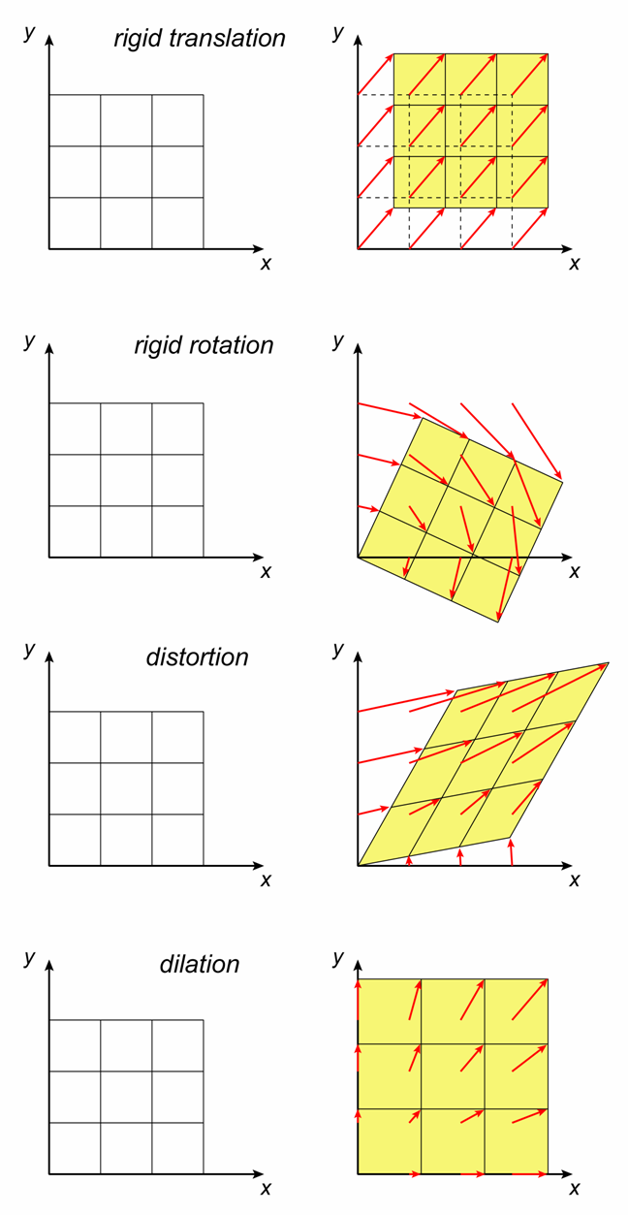
Displacement
There are four basic types of displacement:
Rigid body translation – every particle in the body moves in the same direction and by the same distance
Rigid body rotation – uniform physical rotation of the body; the displacement vectors of the particles are not all the same (they depend upon the location of the particles relative to the axis of rotation) but the distance between particles remains unchanged
Distortion (shape change) – movement of particles so that they change position relative to each other; the displacement vectors are not all the same
Dilation (change in volume without change in shape)
It follows that while deformation involves all four types of displacement, only distortion and dilation produce strain (i.e., change the distance between particles)
Notes:
Figure by Steve Covey-Crump. The displacement vectors (red arrows) connect the position of a particle before deformation with its position after deformation. An array of such vectors, defined for many particles within a body, is described as a displacement field

Slide 8
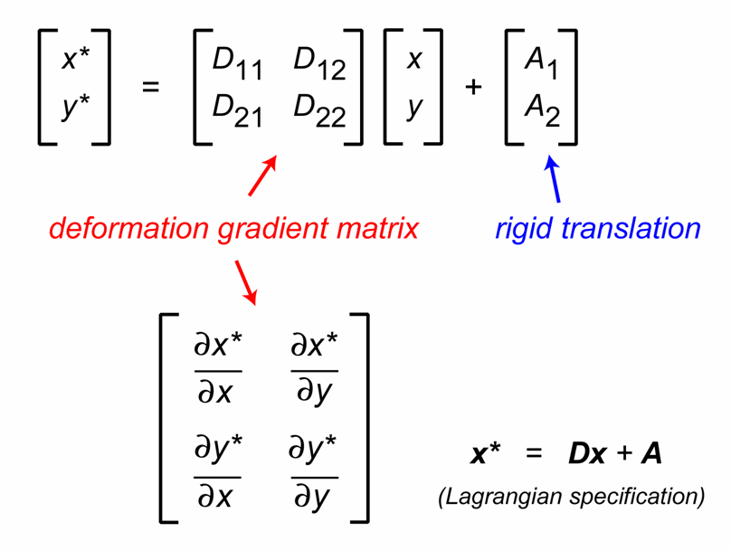
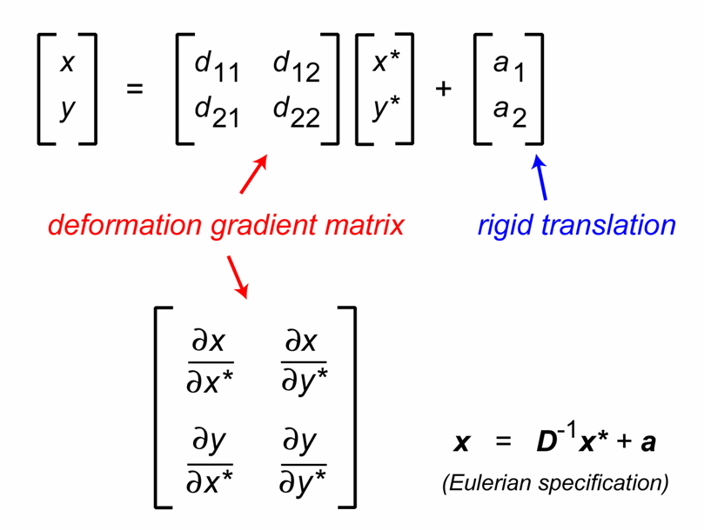
Deformation gradient matrix
In 2d, if the original position of a particle is denoted by ( x , y ) and the position after deformation by ( x* , y* ), then we may write
x* = D₁₁ x + D₁₂ y + A₁
y* = D₂₁ x + D₂₂ y + A₂
The deformation gradient matrix is here defined to give the deformed position using the original position (Lagrangian specification) but it may alternatively be defined to give the original position using the deformed position (Eulerian specification)
Note that by working with gradients, the effect of rigid body translation is eliminated – it is generally not possible to determine the exact amount of rigid translation that a rock has experienced since its formation
Notes:
Slides 8-13 provide a short introduction to the core concepts in the mathematical theory of strain. These are developed a little further in the supporting document, StrainNote.pdf. These slides are primarily here for those who are interested. As far as this course unit is concerned, all I would like you to take away from these six slides is (a) that the state of strain at a point is not a single number but rather is a matrix of 9 terms (in 3d) of which 6 are independent, and (b) that the linear (longitudinal) strains are the terms on the leading diagonal of this matrix while the (tensor) shear strains are the off-diagonal terms
Since only distortion and dilation produce strain, the mathematical treatment of strain begins with the steps needed to separate out the rigid translation and rigid rotation from the overall deformation. This is done by working with displacement gradients (see next slide)
In many of the slides discussing the underlying concepts of strain theory, we shall work in 2d. The extension to 3d is generally straightforward (see StrainNote.pdf)
I have written the two equations on the top left of this slide as a matrix equation in the top right diagram. Those of you who have met matrices before and know how to multiply and add matrices together will see at a glance that this is true. An appreciation of matrix algebra (how to add and multiply two matrices together and how to carry out various other operations) is fundamental for almost all rock mechanics calculations. Matrix algebra is very powerful. A proper introduction to the subject is beyond the remit of this course although it is not actually very difficult

Slide 9
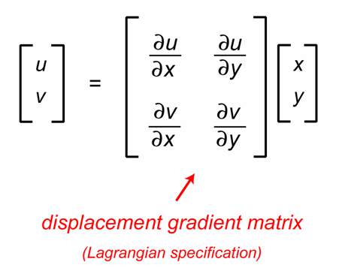
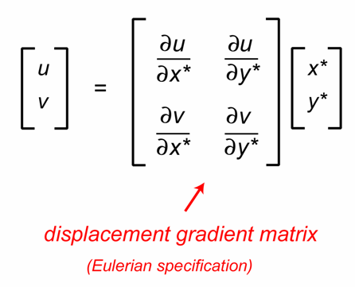
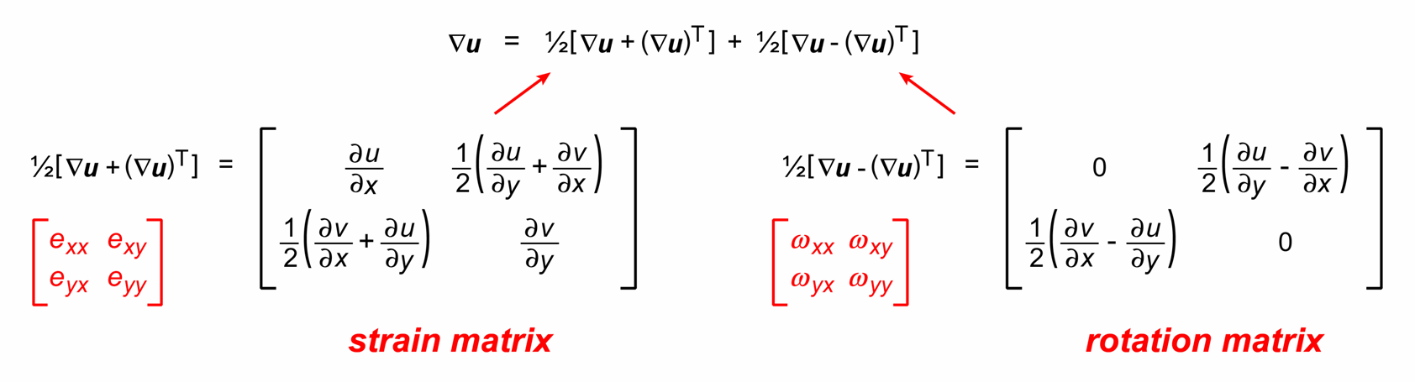
Displacement gradient matrix
The deformation gradient matrix includes rigid body rotation which, like rigid translation, does not contribute to the internal deformation of the body
To separate out the rigid rotation, we work with displacements,
u = x* - x ; v = y* - y
and we examine how displacement varies in the neighbourhood of a point (i.e., we examine the displacement gradients)
We split the displacement gradient matrix into symmetric and antisymmetric parts; the former gives strain (distortion + dilation), and the latter the rotation
Notes:
Note that the displacement gradient matrix can be specified with respect to the original particle positions (Lagrangian specification) or with respect to the deformed particle positions (Eulerian specification). If the displacements are small enough then the displacement gradients are the same whether they are calculated with respect to the original positions or with respect to the deformed positions. Treating the displacements as small enough for this to be true is described as the infinitesimal strain approximation. It leads to a great simplification of the mathematics and is valid for many rock mechanics problems of interest (e.g., deformation around boreholes, deformation during the passage of a seismic wave)
The use of bold text for u in the bottom diagram indicates a vector, here with components u parallel to the x-axis and v parallel to the y-axis. The upside-down triangle (∇) in the bottom diagram is known as the ‘nabla operator’ (or ‘del operator’) which simply tells the reader to take derivatives of the quantity on which it is acting (here the displacement vector, u). In this case ∇u is shorthand for the displacement gradient matrix shown in the top right diagram. The superscript T in the matrix equation refers to the transpose of the matrix ∇u, that is, it is obtained by swapping the rows and columns of the matrix. The matrix equation shown in the bottom diagram looks horrible, but it is actually extremely simple once you have a familiarity with how to add matrices together
The outcome of this slide: when we refer to strain, we are actually referring to the symmetric part of the displacement gradient matrix. To reiterate what was said on Slide 6: strain describes only the part of the deformation (albeit the interesting part) that is the result of (or the cause of) the distortion producing forces within the body

Slide 10
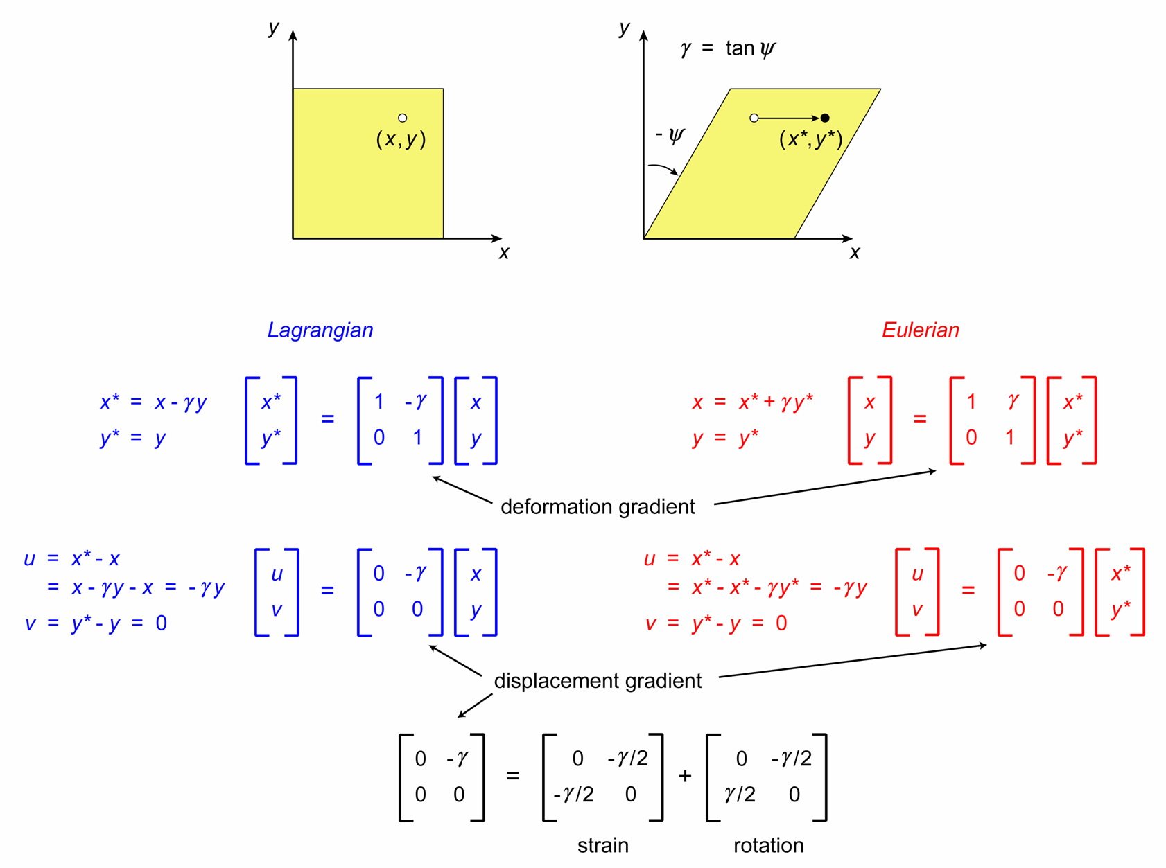
Example: simple shear
Notes:
This slide gives a simple worked example of what has been described on the previous two slides. If you are unfamiliar with matrices, don’t worry about it
Note that although in this example the displacement gradients in the Lagrangian and Eulerian descriptions are the same, this is not usually so unless (as indicated in the notes for the previous slide) the displacements are small (see the accompanying document, StrainNote.pdf – section on finite strain, one dimensional case). Note also that the rock mechanics convention of having shortening as positive requires the sign of the displacement vector to be defined as the negative of that defined by engineers (again see accompanying document)
Ramsay & Huber (Sessions 1 and 4 and Appendices B and C) gives good coverage of transformations using the deformation gradient matrix
Figure by Steve Covey-Crump

Slide 11
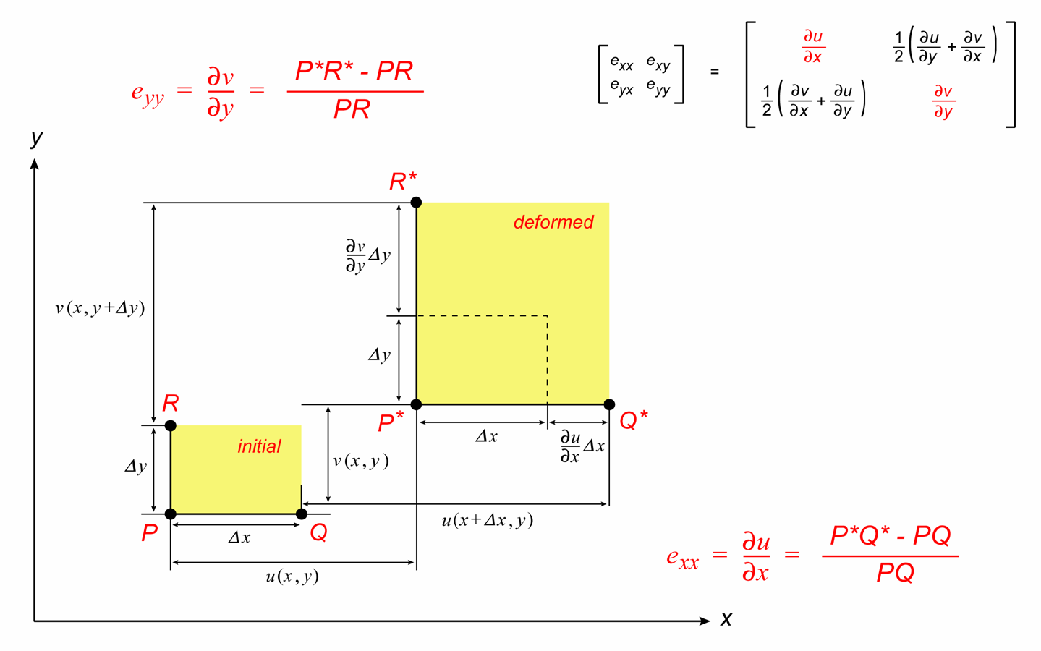
Longitudinal strains
The physical meaning of the strain components on the leading diagonal of the strain matrix can be examined by considering three points P at ( x , y ), Q at ( x + Δ x , y ), and R at ( x , y + Δ y ), that are deformed without change in angle to new positions P*, Q*, R*
Longitudinal strains are change in length/original length
Notes:
The origin of the diagram (by Steve Covey-Crump) shown on this slide is explained in the document, StrainNote.pdf, that accompanies this PowerPoint presentation. The expressions for the strain components are only valid for infinitesimal strains. StrainNote.pdf outlines what is involved here, and what happens if the infinitesimal strain approximation is not used
Clearly,
∂u/∂x = [(∂u/∂x)Δx + Δx - Δx] / Δx
which from the diagram is
∂u/∂x = [P*Q* - PQ] / PQ = (L – L₀) / L₀
that is, change in length divided by original length, which equals engineering strain (see Slide 3) in the x direction

Slide 12
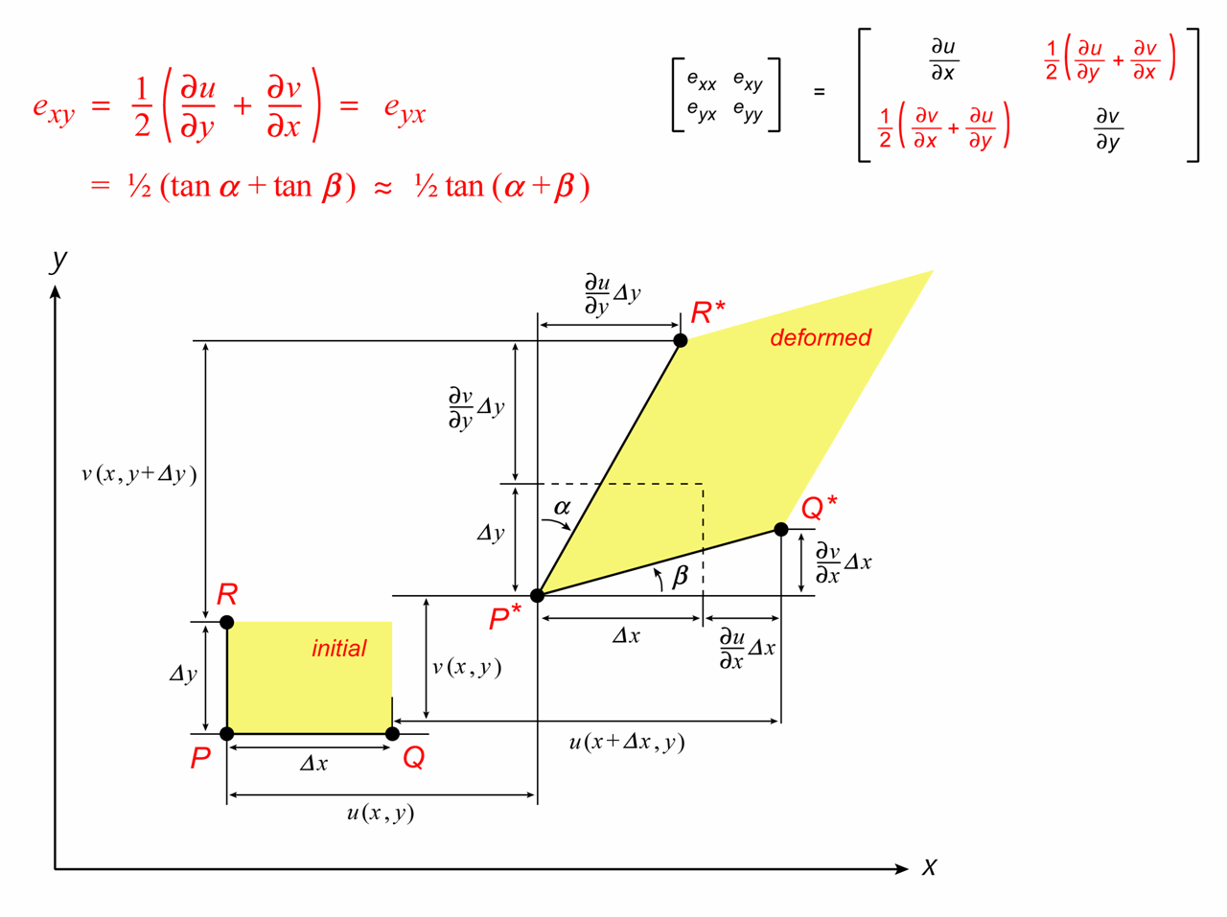
Tensor shear strains
The physical meaning of the off-diagonal terms in the strain matrix becomes apparent if we allow a change in angle between the lines PQ and PR
The off-diagonal terms are half the tangent of the change in angle between two initially orthogonal lines, that is, they are the tensor shear strains
Note that since the strain matrix is the symmetric part of the displacement gradient matrix,
e_{xy} = e_{yx}
Notes:
Again, the origin of the diagram (by Steve Covey-Crump) shown on this slide is explained in the document, StrainNote.pdf, that accompanies this PowerPoint presentation. As noted on the previous slide, the expressions for the strain components are only valid for infinitesimal strains
Using basic trigonometry (tan ψ = opposite / adjacent), if we look at the P*Q*R* part of the diagram we see
tan α = [ (∂u/∂y)Δy ] / [Δy + (∂v/∂y)Δy] ≈ [ (∂u/∂y)Δy ] / [Δy] = (∂u/∂y) where the approximation applies provided that (∂v/∂y) << 1 so that Δy >> (∂v/∂y)Δy
tan β = [ (∂v/∂x)Δx ] / [Δx + (∂u/∂x)Δx] ≈ [ (∂v/∂x)Δx ] / [Δx] = (∂v/∂x) where the approximation applies provided that (∂u/∂x) << 1 so that Δx >> (∂u/∂x)Δx
Hence
½ [(∂u/∂y) + (∂v/∂x)] = ½ [tan α + tan β ]
Also
tan α + tan β ≈ tan (α+β ) provided α and β are small
Hence
½ [tan α + tan β ] ≈ ½ tan (α+β )
½ tan (α+β ) is half the change in angle between two lines that were originally orthogonal, and so it equals half the engineering shear strain

Slide 13
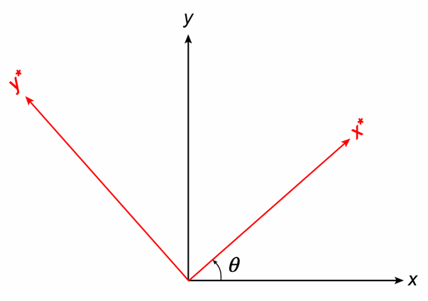
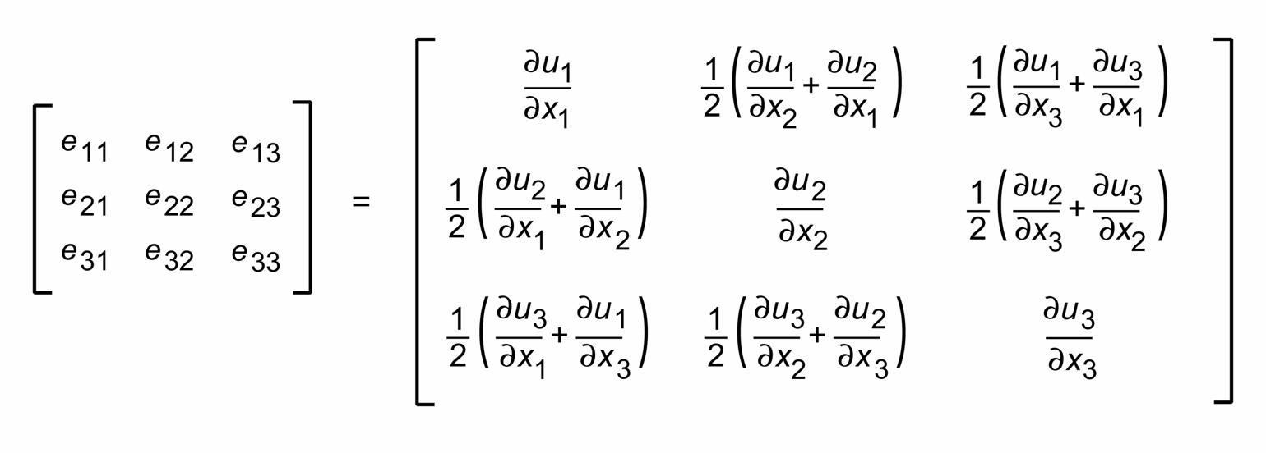
Strain as a 2nd rank tensor
The values of the components in the strain matrix change as the orientation of the coordinate frame is changed, but they do so in a very specific way, that is, they obey a particular transformation equation that is used to define a class of physical quantities called 2nd rank tensors
A tensor is a mathematical quantity that describes the physical state/properties of a material
Tensors are distinguished as being of rank n where 3^{n} is the number of terms required to specify them (in 3d); in 3d the strain is a 3 x 3 matrix (9 components, n = 2)
e₁₂ = e₂₁
e₁₃ = e₃₁
e₂₃ = e₃₂
Strain at a point is not a single number
x,y,z labelling of axes replaced by x₁,x₂,x₃
Symmetric part of displacement gradient matrix
Notes:
Scalars (i.e., physical quantities with magnitude only, e.g., temperature) are 0th rank tensors since they require 3⁰ = 1 term to specify them; vectors (i.e., physical quantities with magnitude and direction, e.g., force) are 1st rank tensors since they require 3¹ = 3 terms to specify them. Quantities like strain that relate two vectors (for strain that is the displacement vector and the position vector) are 2nd rank tensors and require 3² = 9 terms to specify them. Another 2nd rank tensor that we will meet in Class 5 is stress (this relates force and the vector describing the size and orientation of the area over which it is acting). Quantities that relate a vector and a 2nd rank tensor (e.g., piezoelectricity which relates stress and the electric dipole moment (polarization) vector or conversely, strain and electric field) are 3rd rank tensors requiring 3³ = 27 terms to specify them, while quantities that relate two 2nd rank tensors (e.g., elasticity, which relates stress and strain) are 4th rank tensors requiring 3⁴ = 81 terms to specify them. In each case, in order to be a tensor, the components of the tensor must change as the orientation of the coordinate frame used to specify them is rotated, in a way that obeys a particular equation defined for tensors of its rank
Note that given the state of strain at a point in one coordinate frame, the state of strain in a coordinate frame of different orientation may be calculated using the 2nd rank tensor transformation equation
The classic text describing tensors is Nye, 1985, Physical Properties of Crystals: Their Representation by Tensors and Matrices (paperback edition), Oxford University Press

Slide 14
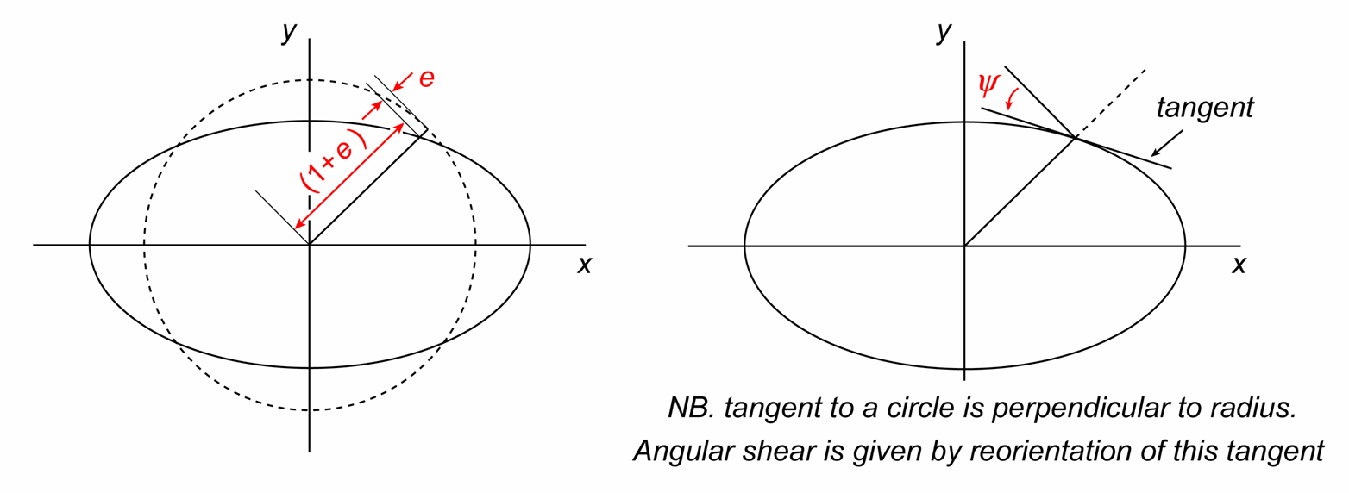
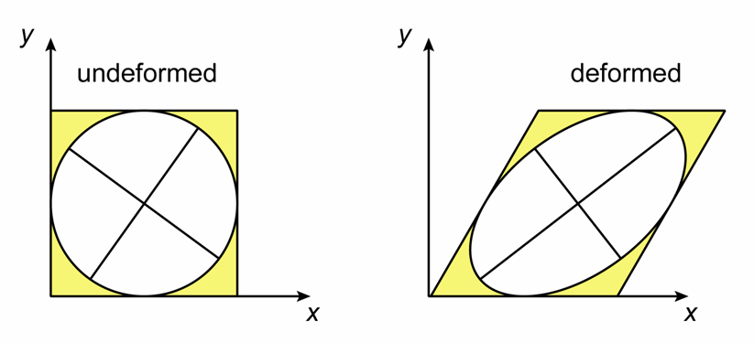
The strain ellipse (2d)
Strain in two dimensions is conveniently visualized using the strain ellipse. This ellipse represents the deformed shape of an initially circular marker, and illustrates how linear strain and angular shear vary with direction
There are two perpendicular directions (the major and minor axes of the ellipse) where the extensions are at maximum and minimum values and the angular shear is zero. These max and min values are termed the principal strains, e₁ and e₂ (where, by definition, e₁ ≥ e₂)
Notes:
The dashed circle (omitted from the right-hand figure) is the undeformed circle, and it has a radius of 1; the ellipse is what that circle turns into after deformation. We could think about this in an alternative way – the ellipse describes how the value of (1+e_{xx}) changes as the coordinate frame is rotated
Note the spelling of ‘principal’.
If the (x,y) coordinate frame is aligned with the principal strains (the axes of the ellipse) then all the off-diagonal terms in the strain matrix are zero (the shear strains are zero) and the values of terms on the leading diagonal of the matrix are e₁ and e₂. Those of you with some knowledge of matrix algebra may therefore appreciate that the principal strains are the eigenvalues of the strain matrix and the directions of the principal strains are the eigenvectors of the strain matrix
Figures by Steve Covey-Crump, top figure based on Twiss & Moores, p.325

Slide 15
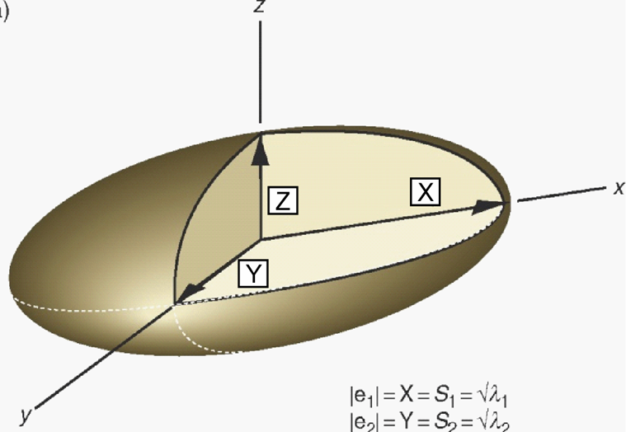
The strain ellipsoid (3d)
Extending the strain ellipse idea to 3d, we have the strain ellipsoid. This represents the deformed shape of an initially spherical object
The three semi-axes of the ellipsoid are the three principal strains; these directions are commonly described as the X, Y, Z directions, and their magnitudes are
X = ( 1 + e₁ ) ; Y = ( 1 + e₂ ) ; Z = ( 1 + e₃ )
X ≥ Y ≥ Z
It is often convenient to work with the ratios of the principal strains
R_{XY} = ( 1 + e₁ ) / ( 1 + e₂ ) ; R_{XZ} = ( 1 + e₁ ) / ( 1 + e₃ ) ; R_{YZ} = ( 1 + e₂ ) / ( 1 + e₃ )
The volumetric strain is
( V / V₀ ) = ( 1 + e_{V} ) = ( 1 + e₁ ) ( 1 + e₂ ) ( 1 + e₃ )
The three principal strain directions are orthogonal, and were also orthogonal in the undeformed state, that is, parallel to them the shear strain is zero. They are the only directions in which this is true
Notes:
The significance of working with ratios of the principal strains will be explored in Exercise 1 of the practical
Figure from Fossen, p.34

Slide 16
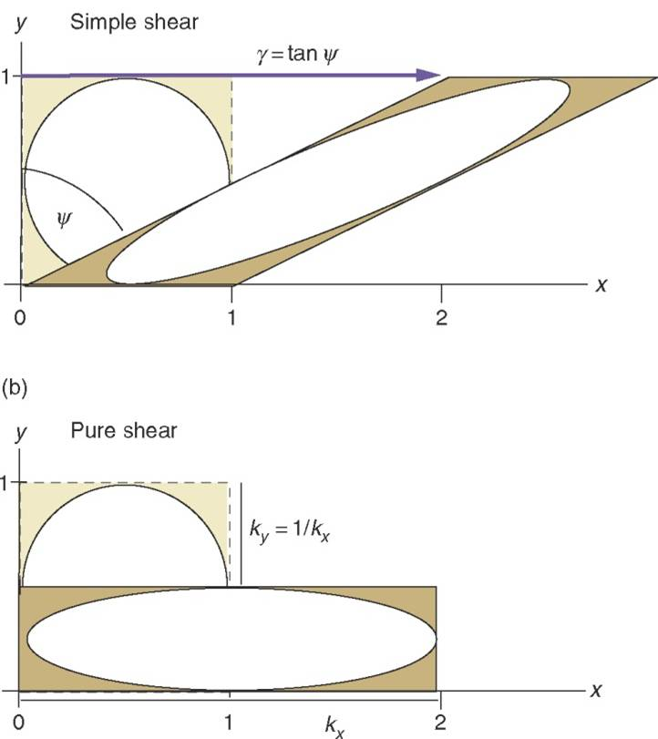
Some important reference states of strain (2d)
There are some simple reference states of strain that it is important to be familiar with
Two end-member types of constant area, two-dimensional strain are
Simple shear: in which the 2d body is subjected to a uniform shear parallel to some given direction without area change; the principal axes of strain rotate during the deformation, and hence such deformation is described as rotational and non-coaxial
Pure shear: extension or contraction involving no area change in which the principal axes of strain do not rotate; such deformation is described as irrotational and coaxial
Notes:
In simple shear an initial square or rectangle is transformed into a parallelogram; in pure shear an initial square or rectangle is transformed into a rectangle of different aspect ratio. One might think that pure shear and simple shear are too simplistic to be of much interest in real deformation, but field observations suggest that situations where these idealizations may be applied are actually very common
Strictly speaking, coaxial and irrotational are not synonymous: rotational/irrotational refers to whether the finite principal strain axes change orientation with respect to some coordinate frame; a coaxial deformation is one in which the finite principal strain axes are parallel to those of the incremental strain ellipsoid (see Slide 21)
Figure from Fossen, p.32

Slide 17
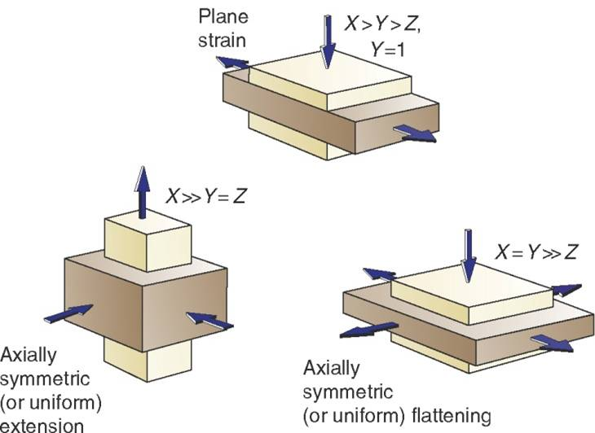
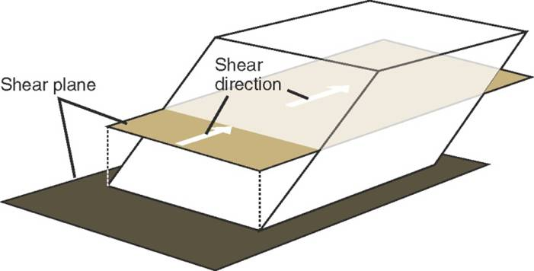
Some important reference states of strain (3d)
Plane strain is when there is no stretching or shortening in one principal direction (Y direction); in such cases the strain can be regarded as two-dimensional
Axially symmetric extension or compression is an irrotational deformation in which the length changes along two principal directions (Y and Z or X and Y respectively) are equal
Example of plane strain, simple shear in which (at large strains) X is parallel to the shear direction, Z is normal to the shear plane, and Y lies in the shear plane at right angles to X and has no stretching or shortening along it
X
Y
Z
Notes:
We shall return to the plane strain, simple shear case next week – it is an important starting point for considering strain in shear zones
Figure top right from Fossen, p.34
Figure bottom left from Fossen, p.39

Slide 18
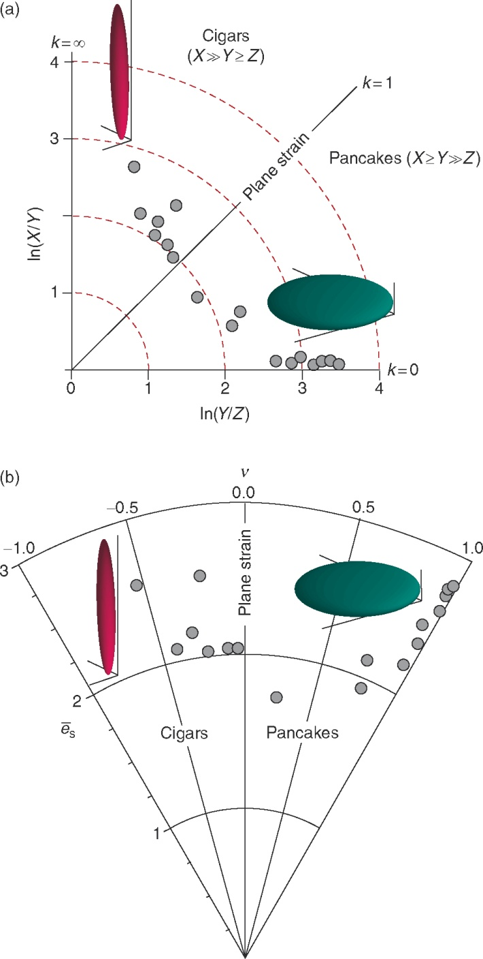
The Flinn diagram
The shape of the strain ellipsoid can be visualized by plotting R_{XY} against R_{YZ} (usually logarithms of these ratios are plotted). Such a diagram is called a Flinn diagram
A Flinn diagram separates strain ellipsoids that have prolate form (cigar shapes) from ones that have oblate form (pancake shapes), that is, it separates deformations dominated by extension in one direction from ones dominated by flattening in one direction
Strain magnitude generally increases away from the origin, but it is not easy to compare strain magnitudes in the various parts of the diagram (the diagram is not designed for this)
Notes:
Figure (from Fossen, p.35) showing a Flinn diagram with some data plotted on it (grey circles)

Slide 19
The Hsü diagram
An alternative plot that allows strain magnitude to be shown, albeit in a way that takes some getting used to, is the Hsü diagram
Strain magnitude is specified by the parameter
ε _{S} = 3^{-½} [ (ε ₁ - ε ₂) ² + (ε ₂ - ε ₃) ² + (ε ₃ - ε ₁) ² ] ^{½}
in which ε₁, ε₂ and ε₃ are the logarithmic principal strains
The shape of the strain ellipsoid is specified using the so-called Lode parameter, ν ,
ν = (2ε ₂ - ε ₁ - ε ₃) / (ε ₁ - ε ₃)
The two parameters are presented on a radial plot with strain magnitude increasing away from the origin
ε_{s}
Notes:
Figure (from Fossen, p.35) showing the same data that were plotted on the Flinn diagram on the previous slide, but this time plotted on a Hsü diagram

Slide 20
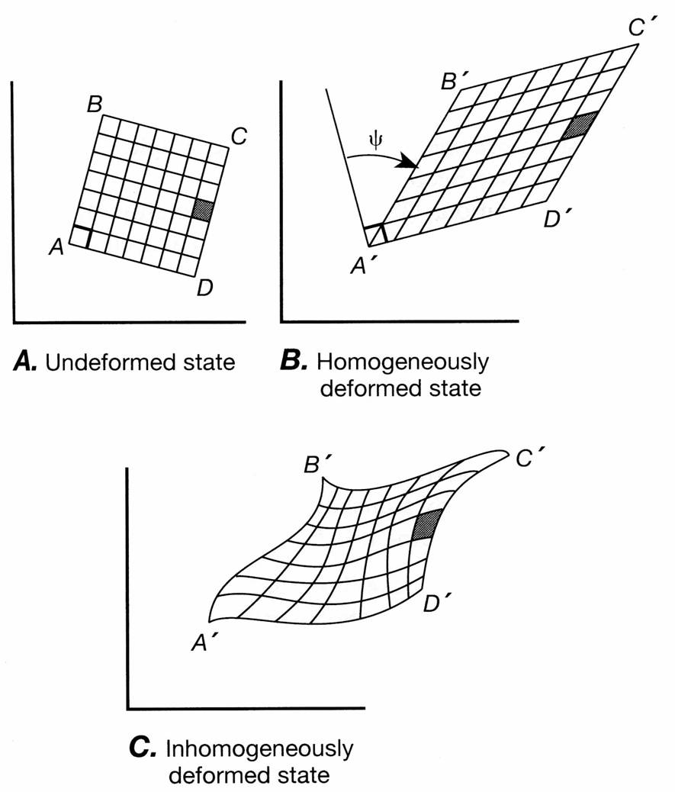
Homogeneous and inhomogeneous strain
Strain is homogeneous if changes in size and shape for each small part of a body are proportionately identical to that for the body as a whole. Planar surfaces remain planar, straight lines remain straight and parallel lines remain parallel
Strain is inhomogeneous if changes in size and shape vary from place to place within the body
The remarks so far in this presentation refer to homogeneous strain. Real strains are inhomogeneous (e.g., straight lines become curved during folding). However, inhomogeneously strained bodies can be analysed by subdividing them into a collection of small, approximately homogeneously deformed, domains
Notes:
In the figure showing homogeneous strain, note that the small square is strained into a parallelogram in exactly the same way as all the other squares, and in exactly the same way as the whole square itself. In the figure showing inhomogeneous strain, the small black square is sufficiently small for its strain to be approximately homogeneous (straight lines remain straight, etc.) but this strain is not the same as the strain of the other elements or of the whole square
Figure from Twiss & Moores, 1st edition

Slide 21
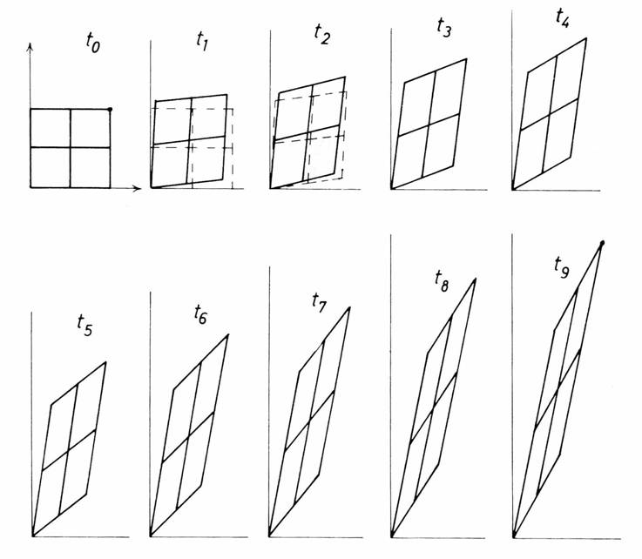
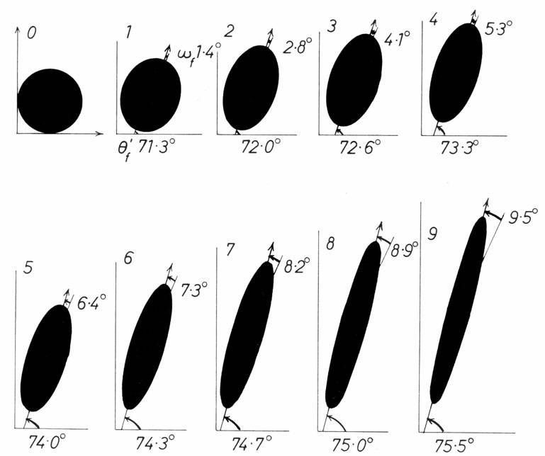
Progressive deformation 1
Strain relates the undeformed to the deformed state but says nothing about the deformation path between these two states
The strain path, and its consequences for the structures that form, may be considered by splitting the deformation up into a series of small strain increments. The strain in each increment is described by the incremental strain ellipse
Evolution of the finite strain ellipse during superposition of nine identical strain increments. The finite strain ellipse changes ellipticity and orientation; the incremental strain ellipse (given in step 1) is constant
Notes:
The incremental strain ellipse is the same in each increment because the displacement changes between any two stages are constant
Figures from Ramsay & Huber, p.218 and 219

Slide 22
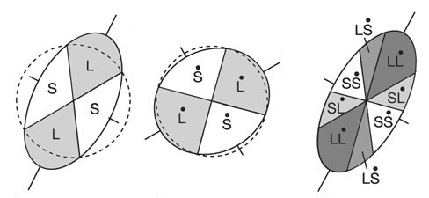
Progressive deformation 2
Since the finite strain ellipse may change shape and orientation in a different way to that of the incremental strain ellipse, it becomes interesting to consider the superposition of the two
Each strain ellipse may be divided into four quadrants in which two lines of no finite longitudinal strain separate sectors in which lines have been lengthened (L) or shortened (S)
When the finite and incremental strain ellipses are combined, if they are in different orientations, eight sectors are now defined, representing four combinations of deformation circumstances
Finite
Incremental
Superposition
Lines which have shortened and in the next increment are continuing to shorten (SS)
Lines which have lengthened but in the next increment are shortening (LS)
Lines which have lengthened and in the next increment are continuing to lengthen (LL)
Lines which have shortened but in the next increment are lengthening (SL)
Notes:
Figure from Twiss & Moores, p.337

Slide 23
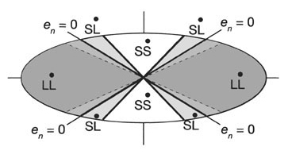
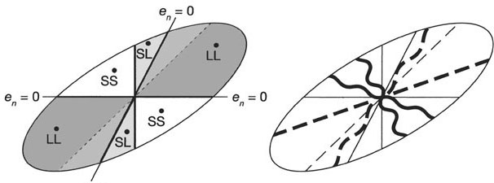
Progressive deformation 3
In principle, if veins are intruded into a rock in a variety of orientations, some might be folded, some boudinaged, some be boudinaged folds, and some folded boudins
Depending upon the geometry of the finite strain and incremental strain ellipses, which orientations of vein experience which of these scenarios differs. Hence something may be said about the strain path by examining the veins carefully
Pure shear
Simple shear with the structures developed in differently oriented competent layers illustrated
Note the different symmetry of the predicted structures (orthorhombic for pure shear; monoclinic for simple shear)
Notes:
Figures from Twiss & Moores, p.338

Slide 24
Practical strain measurement

Slide 25
Practical strain measurement
In principle, measuring strain requires us to determine all six independent terms of the strain tensor. This task is simplified if we can carry out the measurements in the directions of the three principal strains because then the shear strains are all zero. This requires us to have some understanding of how the orientations of the principal strains relate to fabrics such as cleavage and stretching lineations
Most strain analysis is carried out in 2d on planar sections through the strain ellipsoid – the results from differently oriented planes are then combined to give a 3d picture
2d strain analysis relies on the deformed rocks containing some object of known original size or shape. The majority of these strain markers are one of the following:
  Objects that were initially circular (spherical in 3d)
  Objects that were originally elliptical (ellipsoidal in 3d)
  Objects of known original size (length)
  Objects that originally possessed bilateral symmetry
We will explore key techniques in the practical and so the subject is only outlined here
Notes:
Recall that the state of strain in 3d is specified by nine numbers but because the strain matrix is symmetrical, three of the shear strains are equal to three other shear strains and so there are only six independent numbers – three longitudinal strains and three shear strains (see Slide 13). If we choose our coordinate frame to be aligned with the directions of the principal strains, then all the shear strains are zero in that frame and so to specify the state of strain we only need to find the magnitude of the three principal strains (see Slides 14-15) . If we have the three principal strains, then it is possible to calculate all the strain components in any other direction using the 2nd rank tensor transformation equation
It follows that, when measuring strain in the field it is super-important to measure the orientation of cleavage (strike/dip) and any stretching lineation (plunge/plunge direction) if present. These establish a reference frame within which your strain measurement results can be interpreted

Slide 26
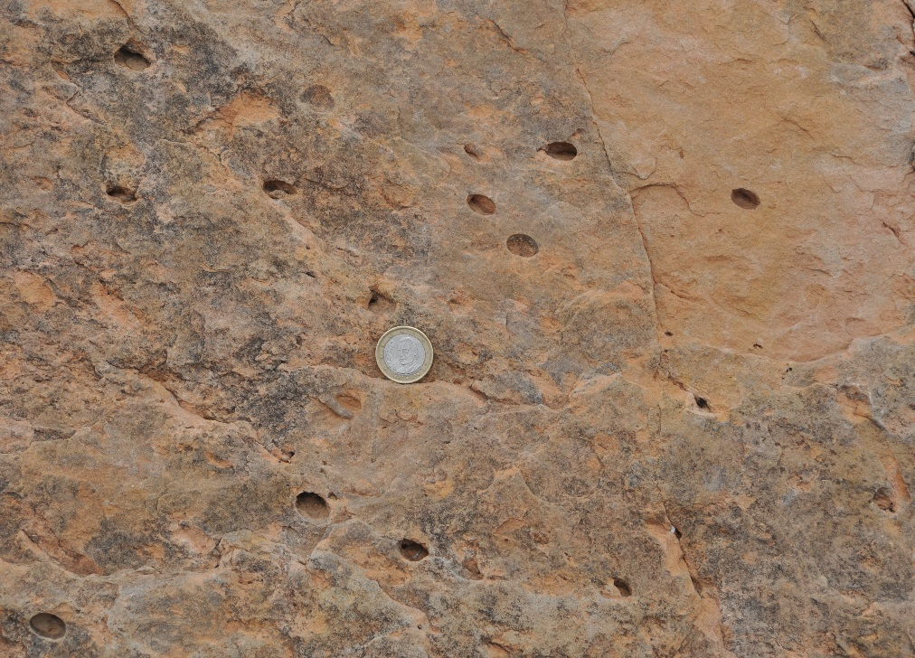
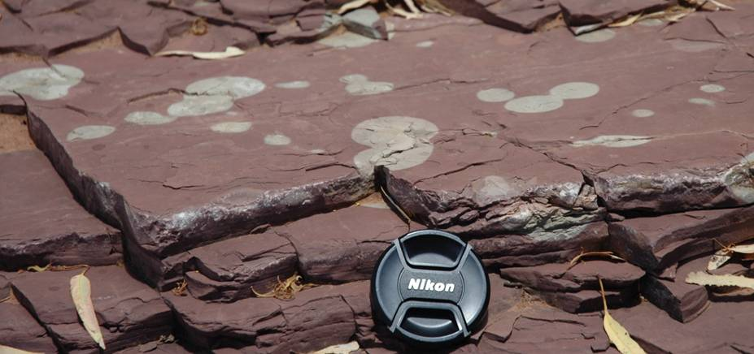
Practical strain measurement (circular markers)
Many objects are known to have initially circular (spherical) shape. These make ideal strain markers because their deformed shape is the actual shape of the strain ellipse
Such markers include reduction spots in mudstones and slates, ooids in limestones, vesicles in lavas, lapilli in tuffs, and bedding plane sections through Skolithos burrows. In addition, other objects such as pillow lavas, sections through columnar basalts, and a range of fossils may be approximated as initially equidimensional
Exercise 1 of the practical takes you through the practicalities of using these markers in a strain analysis
Reduction spots (below); sections through Skolithos burrows (right)
Notes:
Photo left (Steve Covey-Crump): reduction spots on the bedding surface of a red mudstone, Brachina Gorge, Australia.
For an analysis of reduction spots in the Cambrian slates of North Wales, see Tullis & Wood, 1975, Geological Society of America Bulletin 86: 632-638, https://doi.org/10.1130/0016-7606(1975)86<632:COFSFB>2.0.CO;2, and the references by Wood cited within that paper. However, for a claim that the reduction spots in these slates are not actually strain markers, see Nakamura & Borradaile, 2001, Tectonophysics 340: 133-139, https://doi.org/10.1016/S0040-1951(01)00143-3
Photo right (Steve Covey-Crump): Skolithos burrows on a bedding surface, Oliana (see Question 5.1 in Ramsay & Huber, p.73ff, for a worked analysis of such data)
As well as providing information about the strain in the bedding plane, Skolithos burrows provide information about angular shear (with bedding as the shear plane) if they observed on planes perpendicular to bedding because their pre-deformation angle with bedding on these planes is ~ 90°. For examples of analyses of this kind, see
McLeish, 1971, Tectonophysics 12: 469-503, https://doi.org/10.1016/0040-1951(71)90046-1
Wilkinson et al., 1975, Tectonophysics 28: 143-157, https://doi.org/10.1016/0040-1951(75)90033-5
Paulis, 1976, Tectonophysics 34: T29-T36, https://doi.org/10.1016/0040-1951(76)90091-3
Allison, 1979, Scottish Journal of Geology 15: 263-269, https://doi.org/10.1144/sjg15040263
Coward & Kim, 1981, Geological Society, London, Special Publication 9: 275-292, https://doi.org/10.1144/GSL.SP.1981.009.01.25
Fischer & Coward, 1982, Tectonophysics 88: 291-312, https://doi.org/10.1016/0040-1951(82)90241-4
Dias & Ribeiro, 1991, Tectonophysics 191: 389-397, https://doi.org/10.1016/0040-1951(91)90069-5
For a similar analysis using Beaconites burrows see O’Sullivan et al., 1986, Journal of the Geological Society, London 143: 897-906, https://doi.org/10.1144/gsjgs.143.6.0897

Slide 27
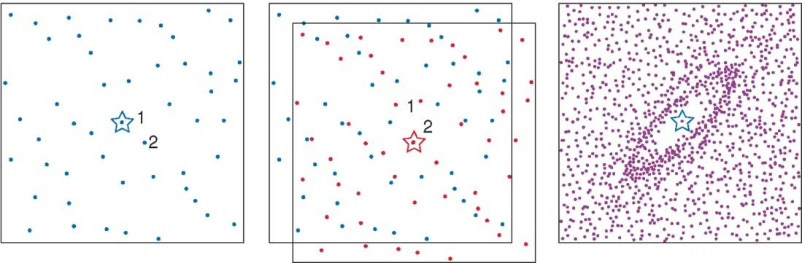
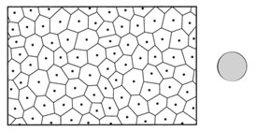
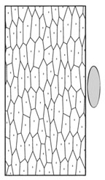
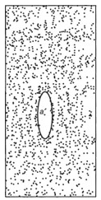
Practical strain measurement (circular markers 2)
If the clasts/grains in a rock were initially equidimensional, then the Fry method provides a rapid and very effective way of estimating the strain. Exercise 3 of the practical will take you through an example of this technique using an oolitic limestone. The centres of originally equant grains in a monomineralic rock could be used equally well (as illustrated below right)
The simple graphical form of the method requires that the grains are not clustered and that they are all of similar size, but computer-based forms of the method allow these restrictions to be relaxed
Notes:
Some important contributions to the Fry method are:
Erslev, 1988, Journal of Structural Geology 10: 201-209, https://doi.org/10.1016/0191-8141(88)90117-4
Erslev & Ge, 1990, Journal of Structural Geology 12: 1047-1059, https://doi.org/10.1016/0191-8141(90)90100-D
Shan & Xiao, 2011, Journal of Structural Geology 33: 1000-1009, https://doi.org/10.1016/j.jsg.2011.02.004
Kumar et al., 2014, Journal of Structural Geology 63: 76-90, https://doi.org/10.1016/j.jsg.2014.03.002
Links to software for applying it are given in Roday et al., 2010, Journal of the Geological Society of India 76: 151-154, https://doi.org/10.1007/s12594-010-0090-0. See also Ramsay & Huber, Session 7
Figure left comes from Fossen, p.67, although it ultimately derives from Ramsay & Huber, p.113
Set of three figures right from Twiss & Moores, p.454

Slide 28
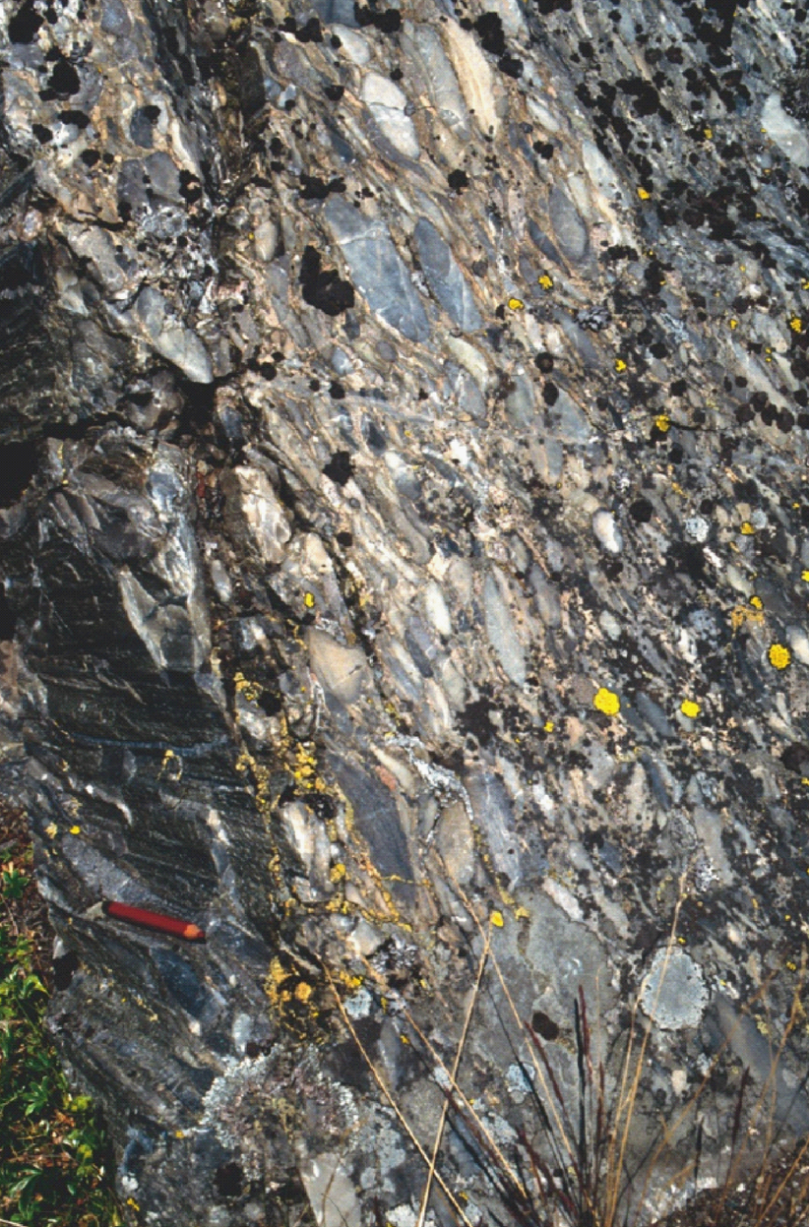
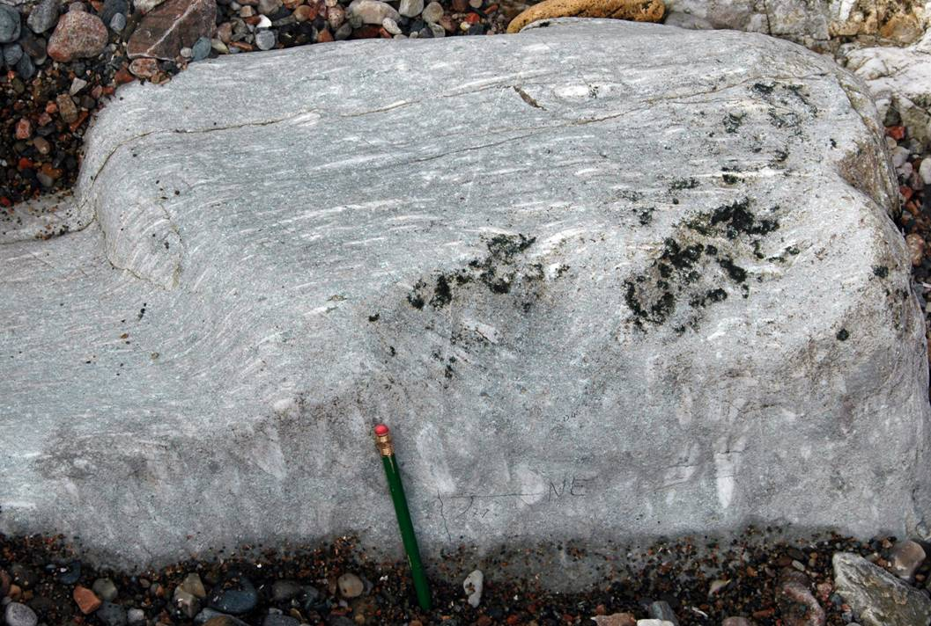
Practical strain measurement (elliptical markers)
If a rock contains objects that were initially ellipsoidal it is possible to separate the initial ellipticity from that imposed by the deformation and so estimate the strain
The classic example of this kind comes from the analysis of the shapes of clasts within deformed conglomerates
Notes:
Photo left (Steve Covey-Crump): a deformed conglomerate in the Onich shore section, near Fort William, Scotland
Photo right (from Fossen, p.68): the Bygdin conglomerate (Norway) which was the subject of a landmark strain analysis in the 1960s (Hossack, 1968, Tectonophysics 5: 315-339, https://doi.org/10.1016/0040-1951(68)90035-8)
In both of these photos, the pencil is approximately in the orientation of the stretching lineation (direction X of the strain ellipsoid). Remember that this direction should be measured in the field together with the best estimate of the XY plane (here the plane of flattening of the pebbles)

Slide 29
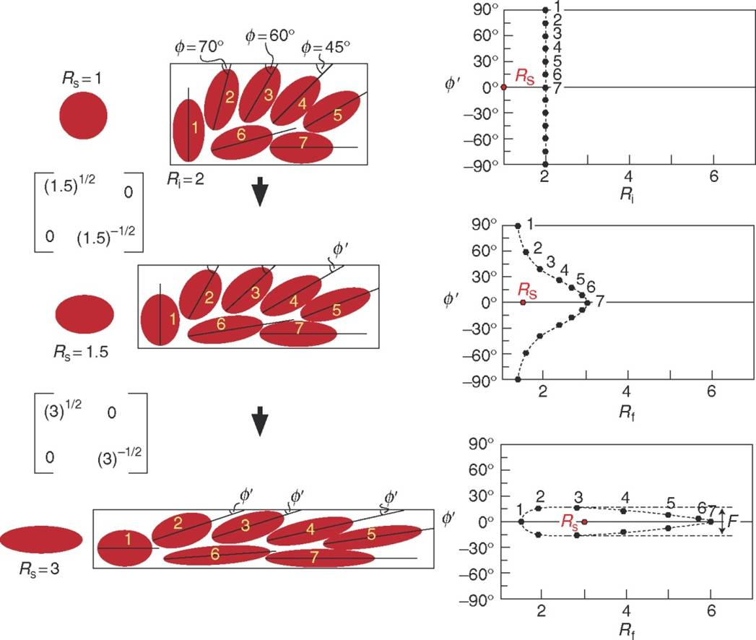
Practical strain measurement (elliptical markers 2)
The method used to analyse elliptical strain markers is the R_{f} /ϕ ´ method. In ideal form this requires that the elliptical markers all have the same initial ellipticity ( R_{i} ) and that there is initially a significant variation in the orientation of their long axes. The final (measured) ellipticity ( R_{f} ) after the imposition of a known strain ( R_{s} ) can be theoretically predicted as a function of initial orientation ( ϕ ) and hence final orientation ( ϕ´ )
The method requires the measured R_{f} to be plotted against final orientation ϕ´ and by then comparing the result with theoretical curves for different R_{i} and R_{s}. Exercise 4 of the practical takes you through the practicalities
Strategies for coping with populations of strain markers that have a range of initial ellipticities have been developed
initial
small strain
larger strain
Notes:
All R are long/short axis ratios. Conglomerate clasts often have a preferred orientation (e.g., through imbrication) but there are usually enough anomalously oriented clasts to allow the technique to be applied
The R_{f}/ϕ technique is outlined in a short book by Lisle, 1985, Geological Strain Analysis: A Manual for the R_{f}/ϕ Technique, Pergamon Press. An Excel spreadsheet approach for implementing the technique is described by Chew, 2003, Computers & Geosciences 29: 795-799, https://doi.org/10.1016/S0098-3004(03)00027-X. See also Ramsay & Huber, Session 5
Figure from Fossen, p.64

Slide 30
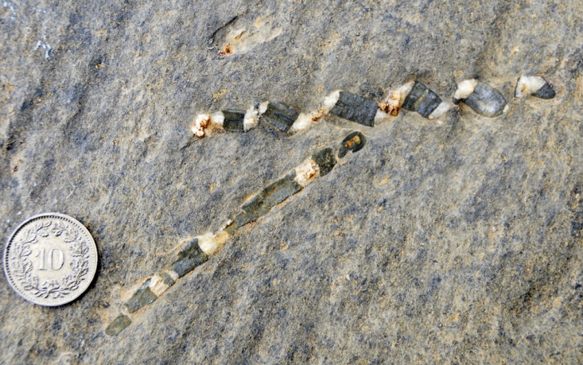
Practical strain measurement (known length)
The strain markers described so far deform with the rock as a whole (or are assumed to). However, other markers may deform by brittle fragmentation without any change in length within the fragments. By adding together the lengths of the fragments in the direction of interest, L₀ may be found, and compared with the deformed length, L, measured from the rock
Linear markers that are much more competent than the matrix, e.g., belemnites or acicular needles of some strong mineral phase (e.g., rutile in quartz)
Linear markers that are easily disaggregated (e.g., crinoid stems)
Fossils with some characteristic dimension (e.g., spacing of thecae in some species of undeformed graptolites)
Two elongated belemnites: the lower one must be close to the maximum extension direction; the fragments in the upper one have been rotated within an overall dextral shear strain field
Notes:
Photo (Fossen, p.60) of fractured and extended belemnites in Jurassic limestones in the Swiss Alps. Note that the rotation of the upper belemnite is a rigid body rotation and so should not be used to infer angular shear
Although calculating strains by adding together the length of fragments in the direction of interest seems straightforward, there are different strategies for doing this (see Ragan, p.321-324)

Slide 31
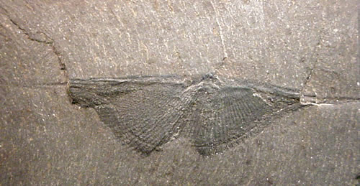
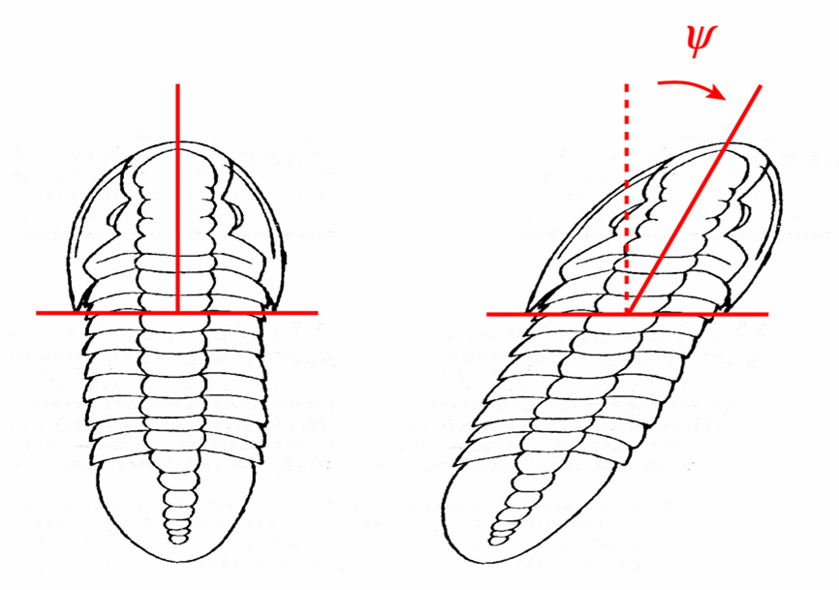
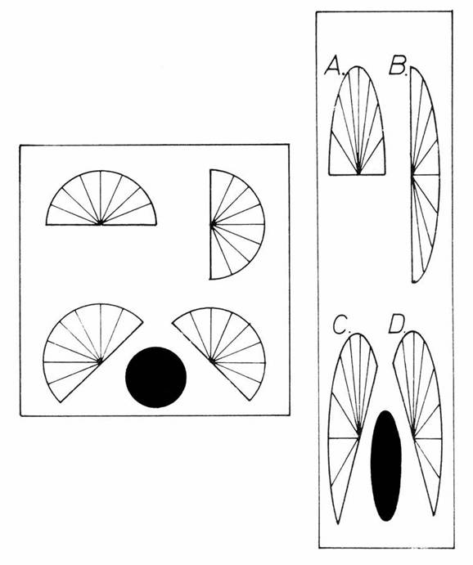
Practical strain measurement (bilateral symmetry)
Many fossils have features that were initially perpendicular (it may require imagination to identify these). These can be used to determine angular shear. In principle, measurement of angular shear in two different directions is enough to establish the ratio of the principal strains
ψ
Delabole butterfly
In the strained brachiopods (right), the hinge line and plane of symmetry are still orthogonal in shells A and B after deformation. Hence these lines in A and B must be parallel to the principal strain directions
Notes:
Figure bottom left by Steve Covey-Crump based on a trilobite (Bathyuriscus) drawn in Ramsay & Huber, p.131. Note that the angular shear is clockwise, that is, it is negative
Figure top right (https://projects.exeter.ac.uk/geomincentre/gallery/2-16.htm): specimen of the brachiopod, Cyrtospirifer verneuili, from the Delabole Slate of Late Devonian age, Delabole Quarry, Cornwall. The quarrymen thought that these fossils looked like butterflies and so they became known informally as the Delabole butterfly. Many, like this one, are strained. Again, note that the angular shear is clockwise, that is, it is negative
Figure bottom right from Ramsay & Huber, p.143

Slide 32
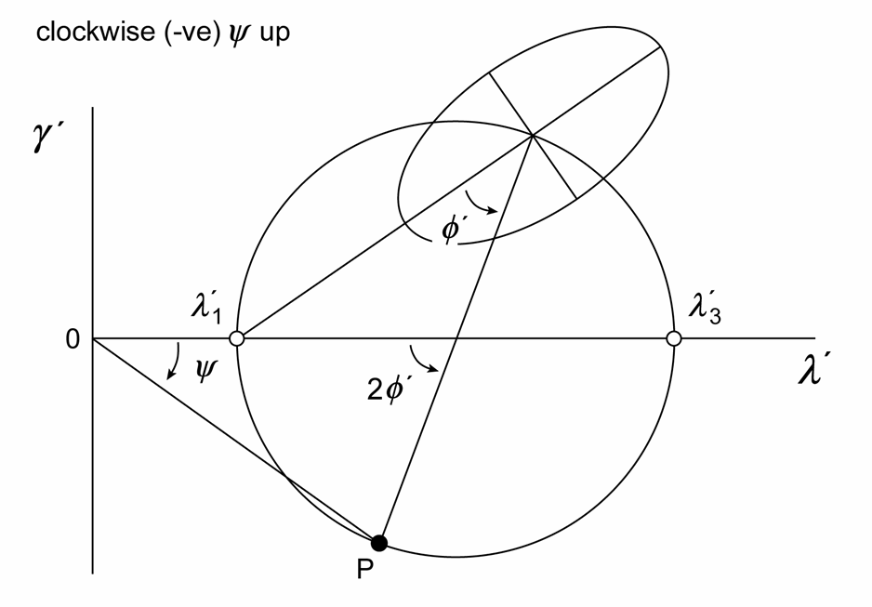
Practical strain measurement (Mohr circle)
Practical strain analysis using changes in line length and/or changes in angle is most conveniently carried out graphically using the Mohr construction
The strain parameters, reciprocal quadratic elongation, λ ´ = 1 / ( 1 + e ) ², and gamma prime, γ ´ = γ / ( 1 + e ) ², may be written in the same form as the parametric equations of a circle. This circle gives the state of strain for any line inclined at angle ϕ ´ to the maximum extension direction λ ₁´ in a plane
The usefulness of this construction will be explored in Exercise 2 of the Practical
Mohr construction illustrated for a line oriented at angle ϕ ´ to the maximum extension direction, λ₁´. The line is represented by point P; the angular shear is given by the angle ψ, and the extension may be obtained by reading off the λ´ axis
Note that the clockwise up convention is relatively new – Ramsay and Huber use the opposite convention
Notes:
Ragan, p.313-328, is a particularly helpful account of the use of the Mohr circle construction in strain analysis, but Ramsay & Huber, Sessions 6 and 8, is also good. MohrStrain.pdf accompanying this PowerPoint presentation provides worked examples of the use of the Mohr circle for strain for all the commonly encountered situations
We will revisit the Mohr circle construction in simpler form when we consider stress (Class 5)
Figure by Steve Covey-Crump based on Ragan, p.314 and p.315

Slide 33
Comments and strain in real structures

Slide 34
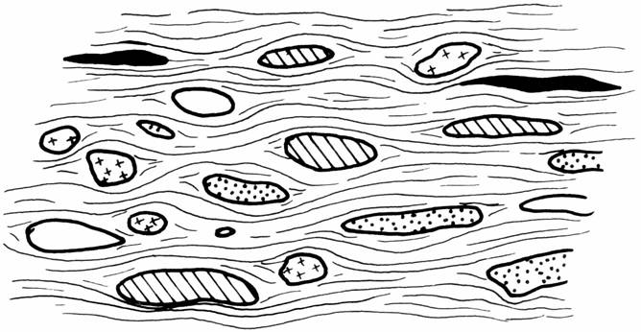
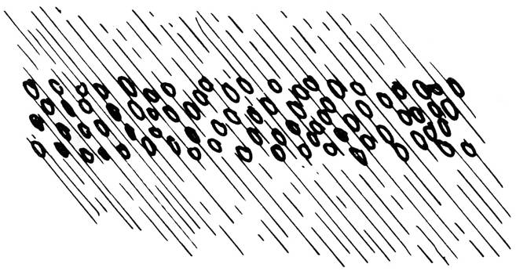
Comments on strain measurement
The strain values obtained using the preceding techniques indicate the strain state of the markers. If there are differences between the mechanical properties of strain marker and its host matrix, care is needed when interpreting the strain results
Some markers (e.g., reduction spots, lapilli) have very similar mechanical properties to their host rock; others (e.g., pebbles within a conglomerate) do not. In such circumstances analysis of fabrics such as cleavage provide an indication of any microscale variations in strain
Polymict conglomerate (left) and lapilli tuff (right). The irregularity of the cleavage planes in the conglomerate points to local variations in strain; the lack of cleavage refraction in the tuff shows
that the strain in the lapilli-rich layer is the same as in the adjacent tuff
On a field scale, it is necessary to establish whether a strain measurement has regional significance or whether it is related only to some local structure
Notes:
Lapilli are originally spherical masses of tuffaceous material within a matrix of identical tuff. They are thought to form around water droplets as rain falls through an erupting cloud of ash
Figures from Price & Cosgrove, p.17,18

Slide 35
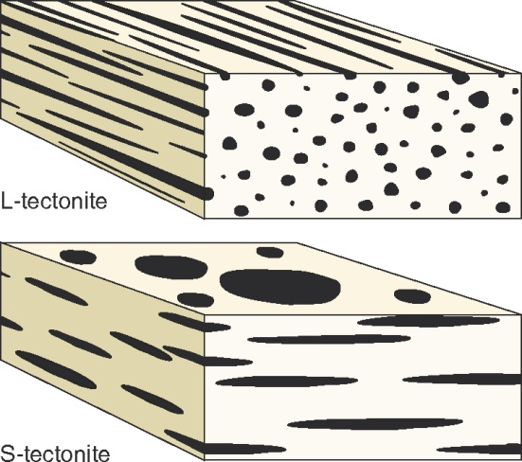
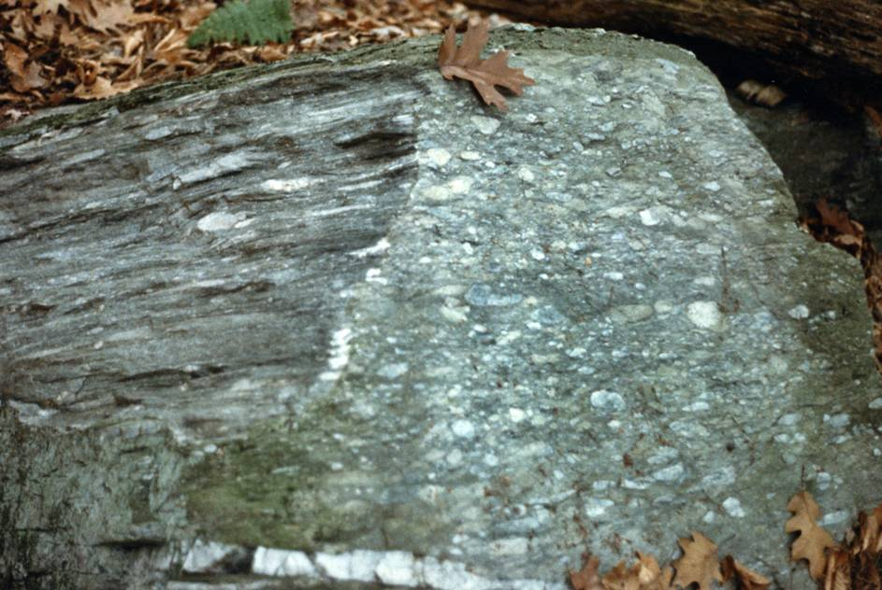
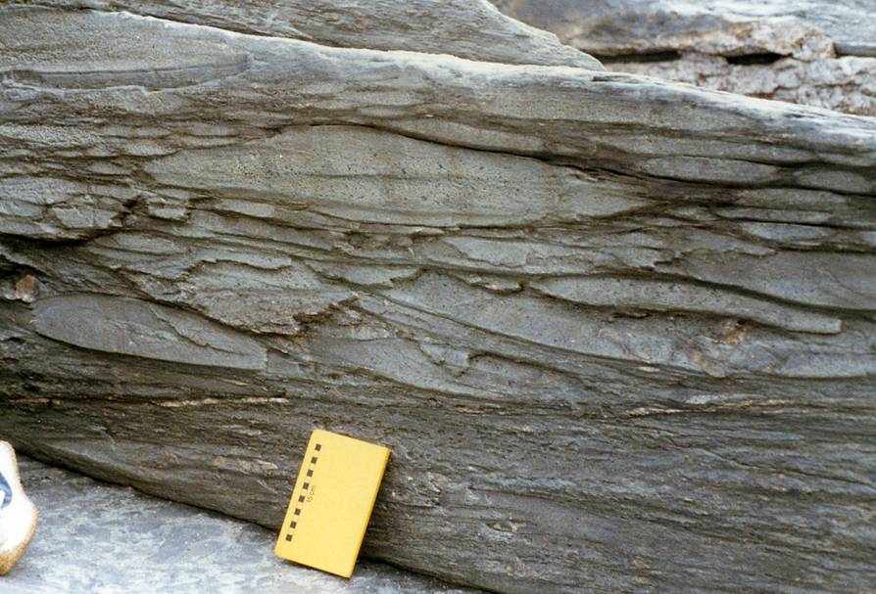
Fabrics and the shape of the strain ellipsoid
In moderate to high grade deformed metamorphic rocks, the nature of the fabric provides the most immediate impression of the geometry of the strain ellipsoid. If linear elements dominate (prolate ellipsoid) the rock is described as an L-tectonite; if planar elements dominate (oblate ellipsoid) it is an S-tectonite. Those with both a strong foliation and a strong lineation are LS-tectonites
L-tectonite (cigar-shaped pebbles)
“S-tectonite” (flattened pillow lavas)
Notes:
Figure top right from Fossen, p.285
Photo left (Steve Covey-Crump): a deformed conglomerate from New England, eastern USA (L-tectonite)
Photo right (Steve Covey-Crump): flattened pillow lavas from Tintagel, Cornwall (S-tectonite). Identifying the flattened pillow lavas as an S-tectonite is actually pushing the point – we can’t see the third dimension, and the scale of the fabric is rather too large for the ‘tectonite’ terminology

Slide 36


Cleavage = XY plane of the strain ellipsoid
Cleavage in deformed rocks is generally assumed to represent the XY plane (principal flattening plane)
Shortening in the Z direction (the normal to the XY plane) may or may not be compensated by extension within the plane of cleavage – if it is not then volume loss in this direction is implied
Within shear zones, cleavage tracks the XY plane across the shear zone (Class 4)
However, cleavage formed as shear bands (e.g., within shear zones, as in the figure above left) does not directly relate to the strain ellipsoid; nor does crenulation cleavage
Notes:
Volume loss in the Z-direction may occur through pressure solution (see Optional PowerPoint presentation)
Passchier & Trouw, 2005, Microtectonics (2nd edition), p.94-95, offer some cautionary words about equating cleavage with the XY plane. Note that crenulation cleavages do not represent the XY plane for the total strain in the rock since they are formed well after deformation has begun
Figure left from Fossen, p.295
Figure right by Steve Covey-Crump modified from an original by Ernie Rutter

Slide 37



Strain variation across folds
The different folding mechanisms lead to different patterns of strain variation within the profile plane
Variations of these patterns occur depending (a) upon the extent of layer-parallel shortening before initiation of the fold, and (b) upon the nature of post-buckle flattening
neutral surface
Tangential Longitudinal Strain
These are plane strain models in which Y is parallel to the fold axis and XZ is the profile plane. In shear folding, Y is not generally parallel to the fold axis, and X and Z do not generally lie in the profile plane
Flexural flow
Shear folding
Notes:
Note that in the TLS folds, strain is at a maximum in the hinge and a minimum at the inflection point (although the figure on the slide doesn’t capture this because it doesn’t reach the inflection point), whereas in the other two folding mechanisms the reverse is the case. In TLS folds the strain is contractional on the inner arc, extensional on the outer arc, and between these two states is a surface of zero strain described as the neutral surface
Figure top from Ramsay & Huber, 1987, Techniques of Modern Structural Geology. Volume 2: Folds and Fractures, Academic Press, p.458
Figure bottom left from Ramsay & Huber, 1987, Techniques of Modern Structural Geology. Volume 2: Folds and Fractures, Academic Press, p.447
Figure bottom right from Twiss & Moores, p.371

Slide 38


Strain around fold hinges
Cleavage can also show a variety of patterns in the hinge zone of folded interbeds, in part reflecting the amount of layer-parallel shortening prior to the initiation of folding (when cleavage starts to form)
The formation of neutral points (areas of no cleavage), reflects variations in the local orientation of the XY plane – the layer-parallel cleavage below the neutral point in the incompetent unit (units shaded black and pale blue in the two figures) reflects outer arc stretching (tangential longitudinal strain folding) in the underlying more competent unit
Notes:
Recall from the last class (Class 2), outer arc stretching is characteristic of folds formed by tangential longitudinal strain (see previous slide)
Figures from Fossen, p.292

Slide 39



Cleavage refraction and strain
We noted in Class 1 that as cleavage passes between more competent and less competent layers it changes in orientation (cleavage refraction). This reflects a difference in shear strain between the layers, and hence in the local orientation of the XY plane
At the interface between the layers, provided there is no slip on the interface, the strain ellipse is shared by the two layers
Notes:
Figure left (from Fossen, p.293): cleavage refraction caused by local shear in the incompetent layers. Note that the cleavage starts forming before the initiation of buckling. (For many years, Manchester students have carried out summer fieldwork at Oliana, NE Spain – the scenario depicted in this figure is one that applies for the folding there in the rare localities where one can see cleavage.)
Figure top right (from Ramsay & Huber, p.184): the inferred variation in strain ellipse across a massive (left) and a graded (right) bed
Figure bottom right (from Fossen, p.293). An example of how this “shared ellipse” feature can be used to good effect when analysing the strain within some folded interbeds around the Rhoscolyn antiform, Anglesey, North Wales, is given by Hassani et al., 2004, Geological Journal 39: 141-156, https://doi.org/10.1002/gj.949

Slide 40

Regional strains (plutons)
Perhaps the most intuitive way of showing regional strain data is as strain ellipse maps. This works well when the strain ellipsoid has axial symmetry
Strain state in the Chindamora granitic batholith, Zimbabwe, as obtained from the shapes of xenoliths.
These were used to deduce a model for the balloon-like magmatic inflation of the igneous body during its emplacement
XZ=YZ strain ellipses
Notes:
For an account of the analysis of xenolith shapes from the Chindamora batholith, see Ramsay, 1989, Journal of Structural Geology 11: 191-210, https://doi.org/10.1016/0191-8141(89)90043-6
Figure from Ramsay & Huber, p.204

Slide 41

Regional strains (folds)
These can also be shown on cross sections . . .
XZ strain ellipses
Strains shown on a profile plane section of the West Helvetic nappe pile, Valais, Switzerland
Notes:
Figure from Ramsay & Huber, p.205
A landmark early study of strain variation around folds which is depicted in similar form to that shown on this slide was by Cloos, 1947, Geological Society of America Bulletin 58: 843-918, https://doi.org/10.1130/0016-7606(1947)58[843:ODITSM]2.0.CO;2. That study determined strain from deformed ooids in limestones around the South Mountain Antiform, Maryland, U.S.A.

Slide 42

Regional strains (folds)
Strains depicted on a section across Central Victoria, Australia. Note the intensification of strain in the Mount Useful Fault Zone, and also how strain intensity is picked up by fold interlimb angle
Notes:
Figure from Gray, 1995, Journal of Structural Geology 17: 1637-1654, https://doi.org/10.1016/0191-8141(95)00068-O. In Class 4 we will consider zones of localized deformation (shear zones) like this
An example of how measurements showing the variation in strain within a fold and thrust belt may be analysed is given by Coward & Potts, 1983, Journal of Structural Geology 5: 383-399, https://doi.org/10.1016/0191-8141(83)90025-1

Slide 43


Regional strains (glaciers)
. . . and can also be used to depict strains in deforming features at the surface such as glaciers . . .
Strains on the surface of a valley glacier (Griesgletscher, Switzerland)
Strains on the surface of a valley glacier (Midre Lovénbreen, Svalbard). These are actually the results of a numerical modelling experiment that aimed to describe the flow of this glacier
Notes:
Strains on deforming surface features are commonly estimated by measuring the changing relative position of a set of marker points, e.g., the changing relative position of a set of stakes on a glacier, of a set of survey stations on a creeping landslip, or of geodetic survey stations (GPS locations) across a region of a tectonic plate. There are various approaches to recovering the strain from the position measurements (for a recent approach and references to alternative strategies, see Robin, 2019, Journal of Structural Geology 124, 211-224, https://doi.org/10.1016/j.jsg.2018.12.011)
Figure left from Hambrey et al., 1980, Journal of Glaciology 25: 215-228, https://doi:10.3189/S0022143000010455
Figure right from Hambrey et al., 2005, Journal of Geophysical Research 110, article F01006, https://doi:10.1029/2004JF000128

Slide 44


Regional strains (landslips)
. . . or creeping landslips
Surface strains of the Mam Tor landslip over the period 1996-2002. Red lines show the axes of the strain ellipse; blue lines are strain trajectories (lines drawn parallel to the principal strains)
Surface displacements of the Mam Tor landslip over the period 1996-2009
Notes:
The Mam Tor landslip at Castleton, Derbyshire, is the subject of ongoing surveys by DEES (led and coordinated by Ernie Rutter). For an overview of this survey work set within the context of other landslips in the local area, see Green et al., 2020, In: Goudie & Migoń, Landscapes and Landforms of England and Wales, Chapter 24, https://doi.org/10.1007/978-3-030-38957-4_24. These surveys have established that over the last 200 years the landslip has been moving at an average rate of 26 cmyr⁻¹. Over this time there have been periods of enhanced movement after prolonged heavy rainfall, particularly in the winter months when vegetation is not as effective at removing groundwater by evapotranspiration processes. The relative instability of the landslip compared with other landslips in the region is because ongoing slip prevents the development of a dendritic stream system that would otherwise drain water from the landslip
Figure left (from Rutter et al., 2003, Journal of the Geological Society, London 160: 735-744, https://doi.org/10.1144/0016-764903-002)
Figure right (from Rutter & Green, 2011, Journal of the Geological Society, London 168: 359-372, https://doi.org/10.1144/0016-76492010-133): showing the measured surface displacement field of the landslip

Slide 45
Reading
Fossen H (2016) Structural Geology (2nd edition). Cambridge University Press. [Chapters 2, 3]
Twiss RJ, Moores EM (2007) Structural Geology (2nd edition). WH Freeman and Co. [Chapters 12, 15]
Price NJ, Cosgrove JW (1990) Analysis of Geological Structures. Cambridge University Press. [p.7-18; helpful summary]
Ramsay JG, Huber MI (1983) Techniques of Modern Structural Geology. Volume 1: Strain Analysis. Academic Press. [Whole book – fantastic reference compendium of techniques]
Ragan DM (2009) Structural Geology: An Introduction to Geometrical Techniques (4th edition). Cambridge University Press. [Chapters 11, 12, 13; Chapter 12 is very good on practical strain measurement]
For those looking for a more rigorous mathematical treatment
Allmendinger RW, Cardozo N, Fisher DM (2012) Structural Geology Algorithms: Vectors and Tensors. Cambridge University Press. [Chapters 7, 8, 9, 10]
Jaegar JC, Cook NGW, Zimmerman RW (2007) Fundamentals of Rock Mechanics (4th edition). Blackwell Publishing. [Chapter 2]

